Slide 1
BASEBALL PITCH PREDICTION
Visesh Kumar Jaiswal
MTH 540-01
Professors : Alfa Heryudono, Scott Field
University of Massachusetts Dartmouth
vjaiswal1@umassd.edu

Slide 3
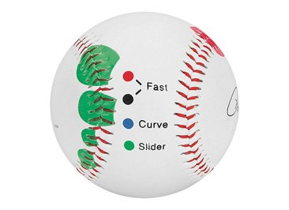
INTRODUCTION ON BASEBALL PITCHES
Every baseball game features hundreds of pitches from 60 feet to 6 inches
Out of all, I have considered 4 of them based on the dataset provided, which are
Fastball
Curveball
Slider
Changeup
All these pitches varies based on the speed, movement and break

Slide 4
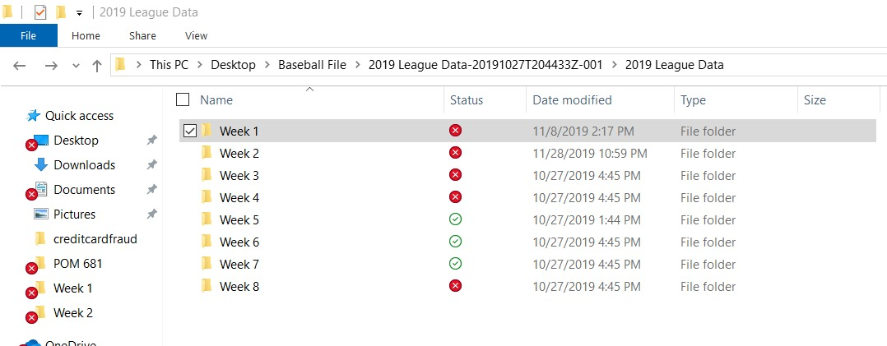
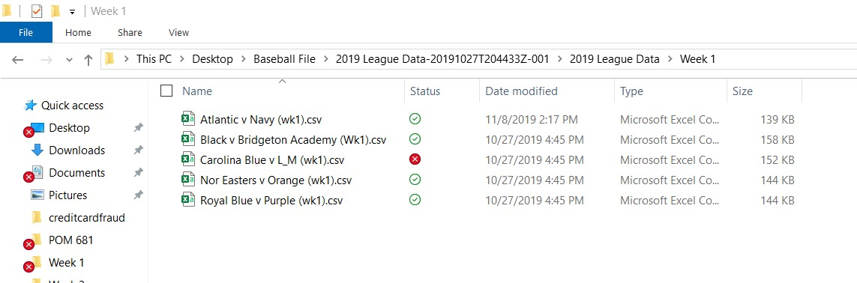
DATASET – CLEANING AND PREPARATION
Baseball dataset has data of different players for 8 weeks
Each week dataset has different teams data in multiple csv files
In order to avoid multiple times of loading files, I have merged all these csv files into one csv file which has 56 variables of 8370 observations

Slide 5
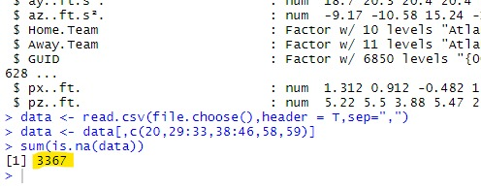
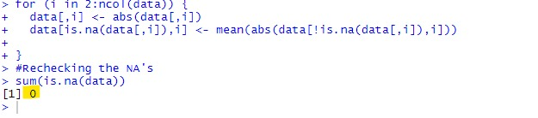
DATASET – CLEANING AND PREPARATION(Cont..)
Among 56 variables, I have considered only 16 quantitative features including horizontal movement, vertical movement, spin rate, spin direction, break angle, start speed etc.
Dataset consists of more than 3000 missing values, which needs to be filled.
If the any of the 16 quantitative variables are missing, then those are filled with mean of the respective columns.
But, if the predicted (pitch type) value was missing then those rows are removed completely.
Before cleaning up the data
After cleaning up the data

Slide 6
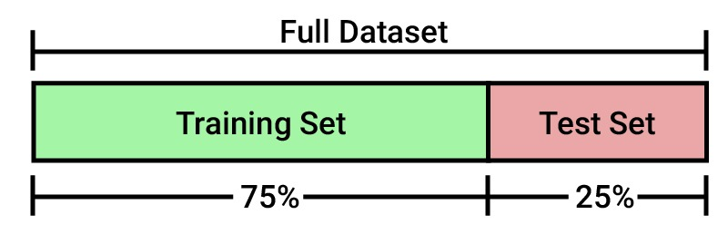
PARTITIONING OF DATA

Slide 7
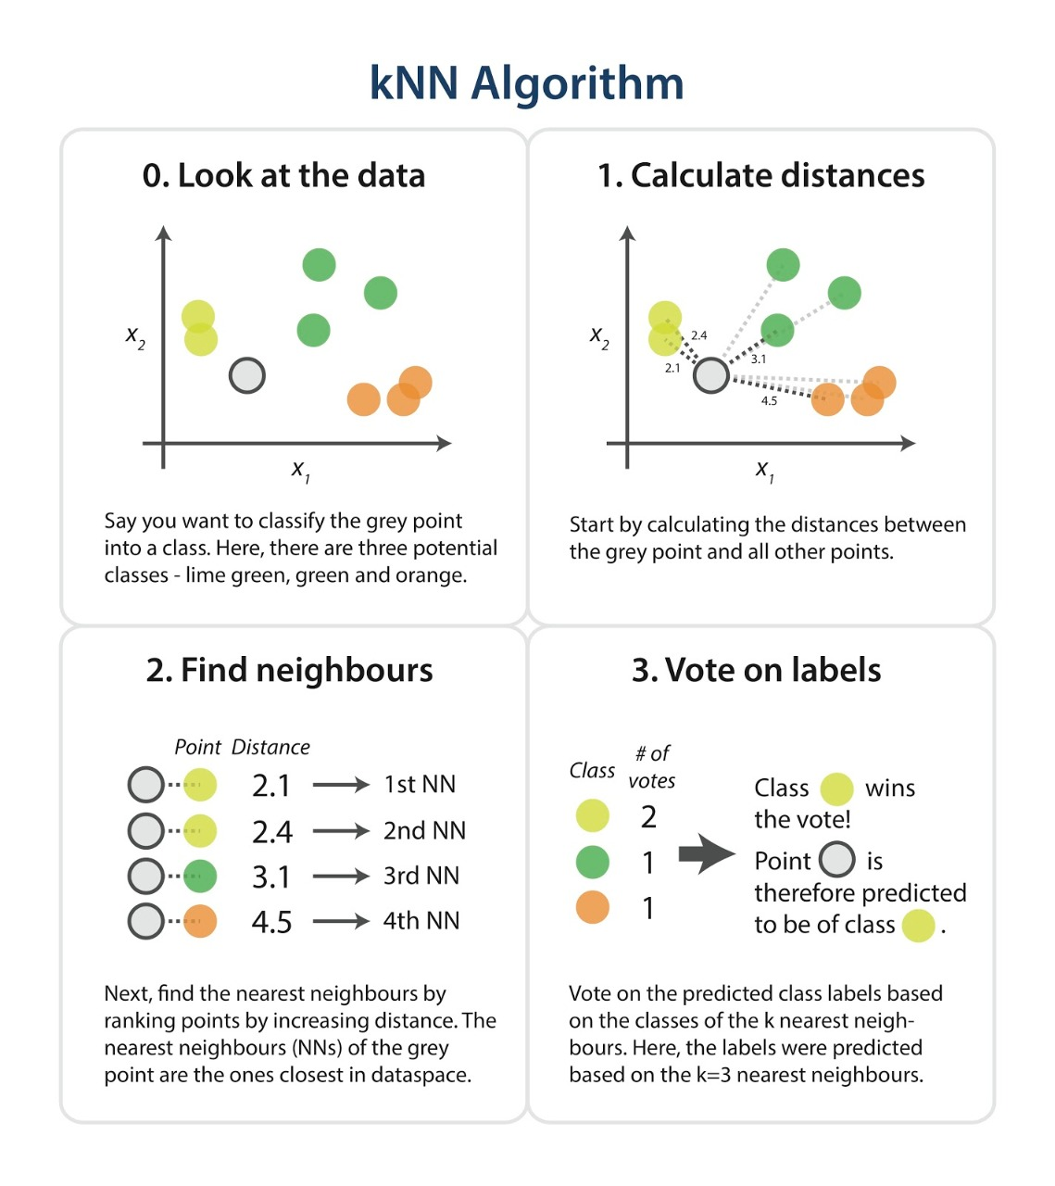
TRAINING THE MODEL
Using kNN algorithm, this model has been trained.
Features like horizontal movement, vertical movement and start-speed are taken two at a time to train the model.
Firstly, removed all those rows which has outliers for features mentioned above.
Secondly, in order to get the better results I have normalized/scaled down the values between 0 and 1.

Slide 8
OUTPUT

